Slide 1

Object Constraint Language

Slide 2
Download USE Tool from https://sourceforge.net/projects/useocl/files/latest/download

Slide 3
Table of Contents
Motivation
Basics of OCL
Specifying invariants
Specifying pre and post-conditions
Navigating in OCL expressions
Basic values and types
Collections in OCL

Slide 4
Motivation
UML diagrams don’t tell everything
Q: What does the following class diagram tell?
House
0..*
owner
Person
houses
1
security
1
1
borrower
0..*
Mortgage
0..*
mortgages
mortgages

Slide 5
What is OCL?
Standard “add-on” to UML
OCL expressions are dependent on types from UML diagrams
Language for expressing additional information (e.g., constraints and business rules) about UML models
Characteristics
Constraint and query languages
Math foundation (set and predicate) but no math symbols
Strongly typed, declarative, and no side effect
High level of abstraction (platform independence)

Slide 6
Basics of OCL
Associating OCL expressions to UML models
Directly to diagrams as notes
Separate accompanying texts, e.g.,
context Person
inv: age >= 0
Person
-age
inv: age >= 0

Slide 7
Invariants
State conditions that must be always be met by all instances of context types (classes or interfaces)
Examples:
context Company inv:
self.numberOfEmployees > 50
context c: Company inv:
c.numberOfEmployees > 50
context c: Company inv enoughEmployees:
c.numberOfEmployees > 50
self: contextual instance, an instance to which the OCL expression is attached
an optional label
An explicit specification of contextual instance, c

Slide 8
Pre and post-conditions
Connditions that must be true at the moment when an operation begins and ends its execution.
Examples
context Account::deposit(amt: Integer): void
pre: amt > 0
post: balance = balance@pre + amt
context Account::deposit(amt: Integer): void
pre argumentOk: amt > 0
post balanceIncreased: balance = balance@pre + amt
pre-value
referring to previous value before the function was called
optional label

Slide 9
Contd.
Referring to pre and result values
@pre: denotes the value of a property at the start of an operations
result: denotes the result of an operation
Examples:
context Account::payInterest(rate: Real): void
post: balance = balance@pre + calcInterest@pre(rate)
context Account::getBalance(): Integer
post: result = balance

Slide 10
Navigating in OCL Expressions
Use dot notation to navigate through associations
Direction and multiplicity matter
Use role names or class names
0..*
owner
Account
accounts
1
Customer
context Account
inv: self.owner … -- evaluate to a single Customer
self.customer …
context Customer
inv: self.accounts->size() … -- evaluate to a collection
self.account … -- of accounts
Arrow notation for collection operations
single line (--) or multiple lines (/* … */)

Slide 11
Types in OCL
Two different kinds
Predefined types (as defined in standard library)
Basic types: Integer, Real, String, Boolean
Collection types: Set, OrderedSet, Bag, Sequence
User-defined types: classes, interfaces, and enumerations.

Slide 12
Pre-Defined: Basic Values
Several built-in types and operations
Type | Values | Operations
Boolean | false, true | or, and, xor, not, =, <>, implies
Integer | -10, 0, 10, … | =, <>, <, >, <=, >=, +, -, *, /, mod(), div(), abs(), max(), min(), round(), floor()
Real | -1.5, 3.14, …
String | ‘Carmen’ | =, <>, concat(), size(), toLower(), toUpper(), substring()

Slide 13
Pre-Defined: Collections
Why?
Multiple objects produced by navigating associations
If multiplicity > 1, collections based on properties
Set: {unique} (default)
OrderedSet: {unique, ordered}
Bag: {notUnique}
Sequence: {notUnique, ordered}
context Account
inv: self.owner.name <> ''
context Customer
inv: self.accounts->size() > 0
0..*
owner
Account
accounts
1
Customer

Slide 14
Examples
Set{10, 100}
OrderedSet{'apple', 'orange'}
Bag{10, 10, 100}
Sequence{10, 10, 100}, Sequence{1..10}, Sequence{1..(5 + 5)}
Set{Set{1}, Set{10}}

Slide 15
Collection Operation
Large number of predefined operations
Arrow notation, e.g., c->size()
0..*
owner
Account
accounts
1
Customer
context Account
inv: not owner->isEmpty()

Slide 16
Collection Operations
Operation | Description
count(o) | Number of occurrences of o in the collection (self)
excludes(o) | Is o not an element of the collection?
excludesAll(c) | Are all the elements of c not present in the collection?
includes(o) | Is o an element of the collection?
includesAll(c) | Are all the elements of c contained in the collection?
isEmpty() | Does the collection contain no element?
notEmpty() | Does the collection contain one or more elements?
size() | Number of elements in the collection
sum() | Addition of all elements in the collection

Slide 17
Iteration Operation
Loop over elements by taking one element at a time
Iterator variables
Optional variable declared and used within body
Indicate the element being iterated
Always of the element type, thus, type declaration is optional
context Customer
inv: self.accounts->forAll(a: Account | a.owner = self)
inv: accounts->forAll(a | a.owner = self)
inv: accounts->forAll(owner = self)

Slide 18
Iteration Operations
Operation | Description
any(expr) | Returns any element for which expr is true
collect(expr) | Returns a collection that results from evaluating expr for each element of self
exists(expr) | Has at least one element for which expr is true?
forAll(expr) | Is expr true for all elements?
isUnique(expr) | Does expr has unique value for all elements?
iterate(x: S; y: T| expr) | Iterates over all elements
one(expr) | Has only one element for which expr is true?
reject(expr) | Returns a collection containing all elements for which expr is false
select(expr) | Returns a collection containing all elements for which expr is true
sortedBy(expr) | Returns a collection containing all elements ordered by expr

Slide 19
Iteration Operations - Examples
accounts->any(a: Account | a.balance > 1000)
accounts->collect(name) -- all the names
accounts->exists(balance > 5000)
accounts->forAll(balance >= 0)
accounts->isUnique(name)
accounts->iterate(a: Account; sum: Integer = 0 | sum + a.balance)
accounts->one(name = ‘Carmen’)
accounts->reject(balance > 1000)
accounts->select(balance <= 1000)
accounts->sortedBy(balance)

Slide 20
Iteration Operations - Examples
accounts->any(a: Account | a.balance > 1000)
accounts->collect(name) -- all the names
accounts->exists(balance > 5000)
accounts->forAll(balance >= 0)
accounts->isUnique(name)
accounts->iterate(a: Account; sum: Integer = 0 | sum + a.balance)
accounts->one(name = ‘Carmen’)
accounts->reject(balance > 1000)
accounts->select(balance <= 1000)
accounts->sortedBy(balance)

Slide 21
The iterate Operation
Most fundamental and generic loop operation
All other loop operations are special cases
iterate(elem: T1; result: T2 = expr | expr-elem-result)
Example
Set{1, 2, 3}->sum()
Set{1, 2, 3}->iterate(i: Integer; r: Integer = 0 | r + i)

Slide 22
USE Tool

Slide 23
Contents
USE Tool
Specifying Models
Defining Models
Defining Classes
Defining Associations
Adding Constraints
Examples

Slide 24
USE Tool
A USE tool requires a textual description of a model using features found in UML class diagrams (classes, associations, etc.).
Expressions written in the Object Constraint Language (OCL) are used to specify additional integrity constraints on the model.

Slide 25
Specifying a UML Model
The USE tool expects a textual description of a model and its constraints as input.
The example must therefore be translated into a USE specification by using an external text editor.
The USE specification of the example model is shown in the next slide.

Slide 26
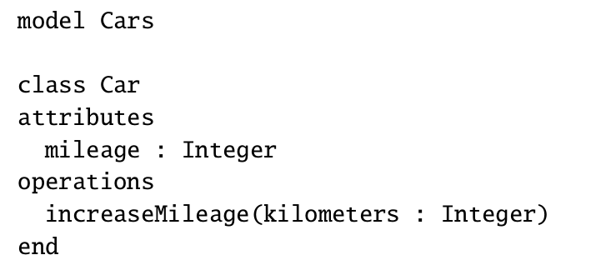
UML Model
USE Tool Specification
Car
-mileage: Integer
+increaseMileage(Kilometers: Integer):void

Slide 27
Defining a UML Model
Every UML Model has a name and an optional body.
The model body consists of at least one class definition and an arbitrary number of association definitions.
At the end of the specification OCL constraints may be defined.
Example:
model Employee

Slide 28
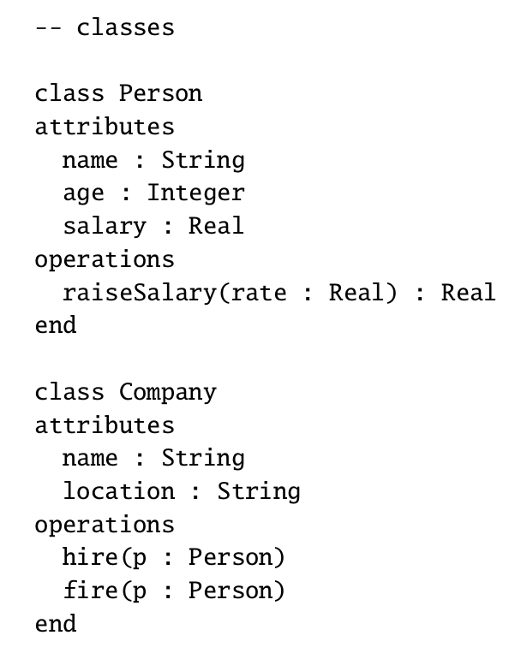
UML Model
Defining Classes
Person
-name:String
-age: Integer
-salary: Real
+raiseSalary(rate:Real):Real
Company
-name:String
-location:String
+hire(p:Person):void
+fire(p:Person):void

Slide 29
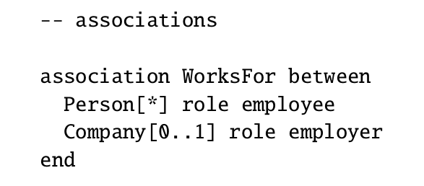
Defining Associations
Person
-name:String
-age: Integer
-salary: Real
+raiseSalary(rate:Real):Real
employee
*
Company
-name:String
-location:String
+hire(p:Person):void
+fire(p:Person):void
WorksFor
0..1
employer

Slide 30
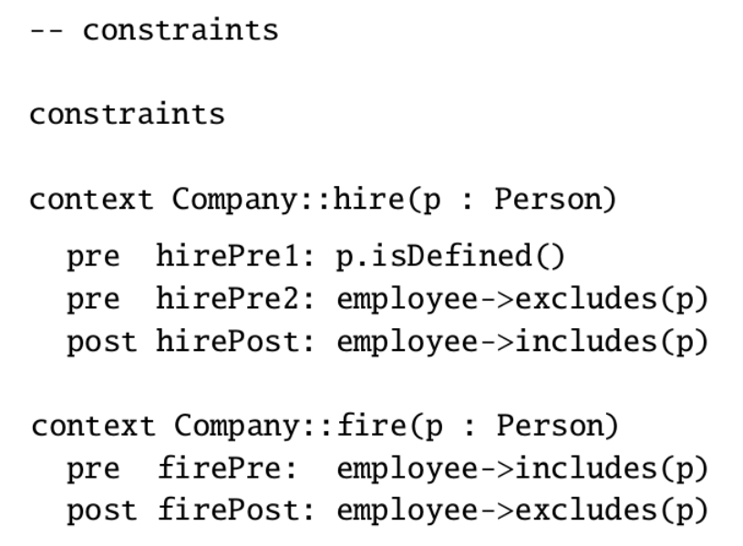
Adding Constraints
Adding Constraints
hire(p:person)
Pre-condition 1: Person p must be defined
Pre-condition 2: p should not already be an employee of the company.
Post-condition: p should become one of the employees of the company
fire(p:Person)
Pre-condition: P must be an employee of the company
Post-condition: P is no longer an employee of the company

Slide 31
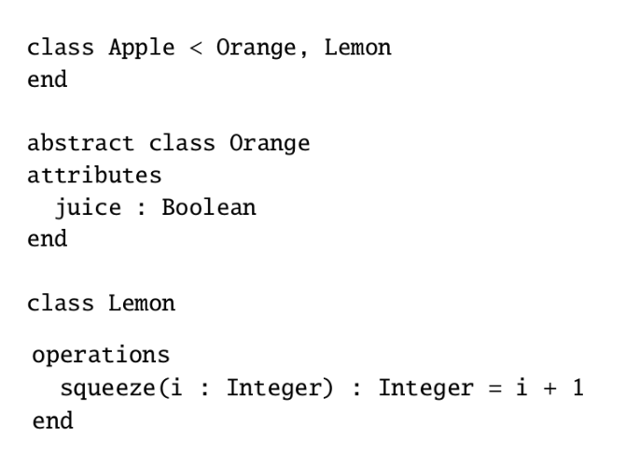
Inheritance in OCL
Orange
-juice:Boolean
Lemon
+squeeze(i: Integer):Integer
extends
extends
Apple

Slide 32
Example 2

Slide 33
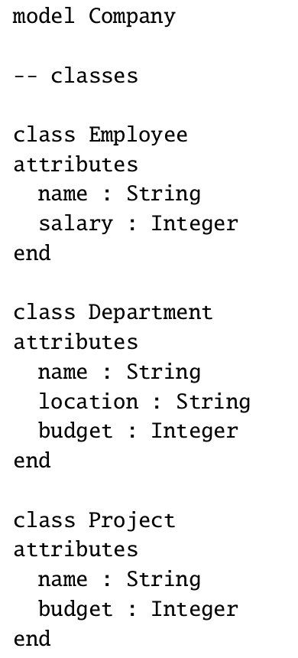
Defining Classes
Employee
-name:String
-salary: Integer
Project
-name:String
-budget: Integer
Department
-name:String
-location:String
-budget: Integer

Slide 34
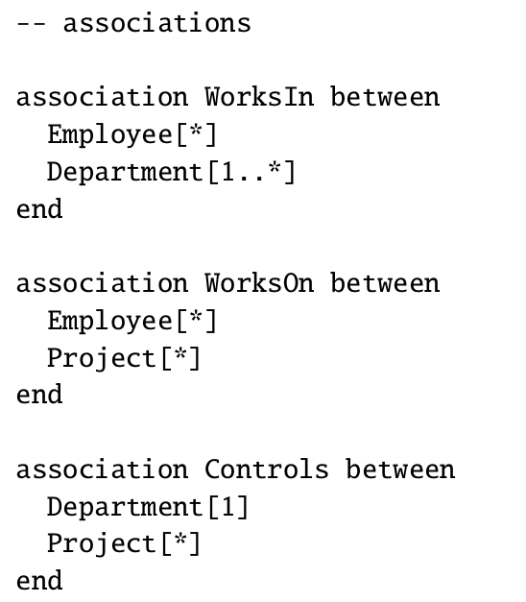
Defining Associations
Employee
-name:String
-salary: Integer
*
*
WorksOn
WorksIn
1..*
*
Project
-name:String
-budget: Integer
Department
-name:String
-location:String
-budget: Integer
*
1
Controls

Slide 35
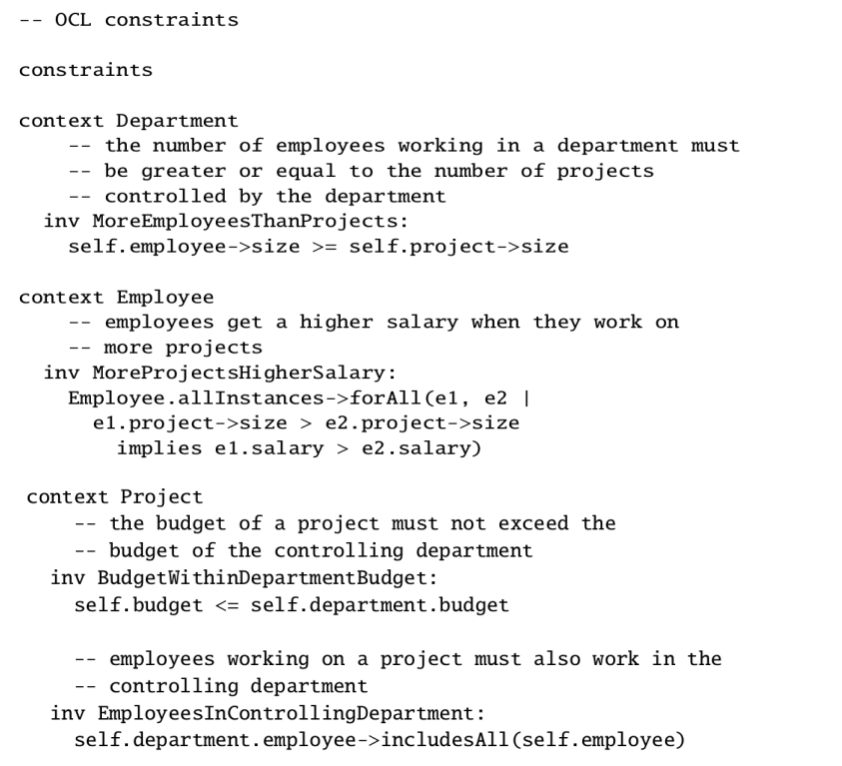
Adding Constrains
The number of employees working in a department must be greater or equal to the no. of projects controlled by the department
The budget of a project must not exceed the budget of the controlling department
Employees working on a project must also work in the controlling department
Employees get a higher salary when they work on more projects

Slide 36
Example 3

Slide 37
Student
Module
0..*
1..*
name: String
taken_by
takes
code: String
credit: Integer
0..*
submitted_by
for_module
set_work
1..*
Assessment
submits
1..*
weight: Integer
Exam
Coursework
hours: Integer
date: String

Slide 38
Constraints
Modules must have more than seven students registered
The assessments for a module must total to 100
Students must register for 120 credits each year
Students must take at least 90 credits of CS modules each year
All modules must have at least one assessment worth over 50
Students can only have assessments for modules which they are taking

Slide 39
Constraint 1
Student
Module
0..*
1..*
name: String
taken_by
takes
code: String
credit: Integer
0..*
submitted_by
for_module
Modules must have more than seven students registered
context Module
inv: taken_by->size > 7
set_work
1..*
Assessment
submits
1..*
weight: Integer
Exam
Coursework
hours: Integer
date: String

Slide 40
Constraint 2
Student
Module
0..*
1..*
name: String
taken_by
takes
code: String
credit: Integer
0..*
submitted_by
for_module
set_work
1..*
The assessments for a module must total to 100%
context Module
inv: set_work.weight->sum( ) = 100
Assessment
submits
1..*
weight: Integer
Exam
Coursework
hours: Integer
date: String

Slide 41
Constraint 3
Student
Module
0..*
1..*
name: String
taken_by
takes
code: String
credit: Integer
0..*
submitted_by
for_module
set_work
1..*
Students must register for 120 credits each year
context Student
inv: takes.credit->sum( ) = 120
Assessment
submits
1..*
weight: Integer
Exam
Coursework
hours: Integer
date: String

Slide 42
Constraint 4
Student
Module
0..*
1..*
taken_by
takes
name: String
code: String
credit: Integer
0..*
submitted_by
for_module
set_work
1..*
Students must take at least
90 credits of CS modules each year
context Student inv:
takes->select(code.substring(1,2) =
‘CS’).credit->sum() >= 90
Assessment
submits
1..*
weight: Integer
Exam
Coursework
hours: Integer
date: String

Slide 43
Constraint 5
Student
Module
0..*
1..*
name: String
taken_by
takes
code: String
credit: Integer
0..*
submitted_by
for_module
set_work
1..*
All modules must have at least one assessment worth over 50%
context Module
inv: set_work->exists(weight > 50)
Assessment
submits
1..*
weight: Integer
Exam
Coursework
hours: Integer
date: String

Slide 44
Constraint 6
Student
Module
0..*
1..*
taken_by
takes
code: String
credit: Integer
name: String
0..*
submitted_by
for_module
set_work
1..*
Students can only have assessments for modules which they are taking
context Student
inv: takes->includesAll(submits.for_module)
Assessment
submits
1..*
weight: Integer
Exam
Coursework
hours: Integer
date: String

Slide 45
Thank you!

